Slide 1

Atliq Hardwares insights
Insights to make quick and smart data-informed decisions

Slide 2
BUSINESS OBJECTIVE
Atliq Hardware, a leading computer hardware producer, aims to enhance its data-informed decision-making capabilities by expanding its Data Analytics team.
The management has noticed a lack of actionable insights, slowing down their decision-making processes and impacting business efficiency.
The goal of this task is to run SQL queries to answer 10 ad hoc business requests and present the findings in a clear and insightful way to aid the top-level management in making strategic decisions.

Slide 3
Requests/Questions
Provide the list of markets in which customer "Atliq Exclusive" operates its business in the APAC region.
What is the percentage of unique product increase in 2021 vs. 2020?
Provide a report with all the unique product counts for each segment and sort them in descending order of product counts.
Which segment had the most increase in unique products in 2021 vs 2020?
Identify the products that have the highest and lowest manufacturing costs.
Generate a report with the top 5 customers who received a high average discount percentage in 2021 within the Indian market.
Get the complete report of the gross sales amount for the customer “Atliq Exclusive” for each month.
Determine the quarter in 2020 that had the maximum total sold quantity.
Identify the channel that contributed the most to gross sales in 2021, along with its percentage contribution.
Get the top 3 products in each division that had a high total sold quantity in 2021.

Slide 4
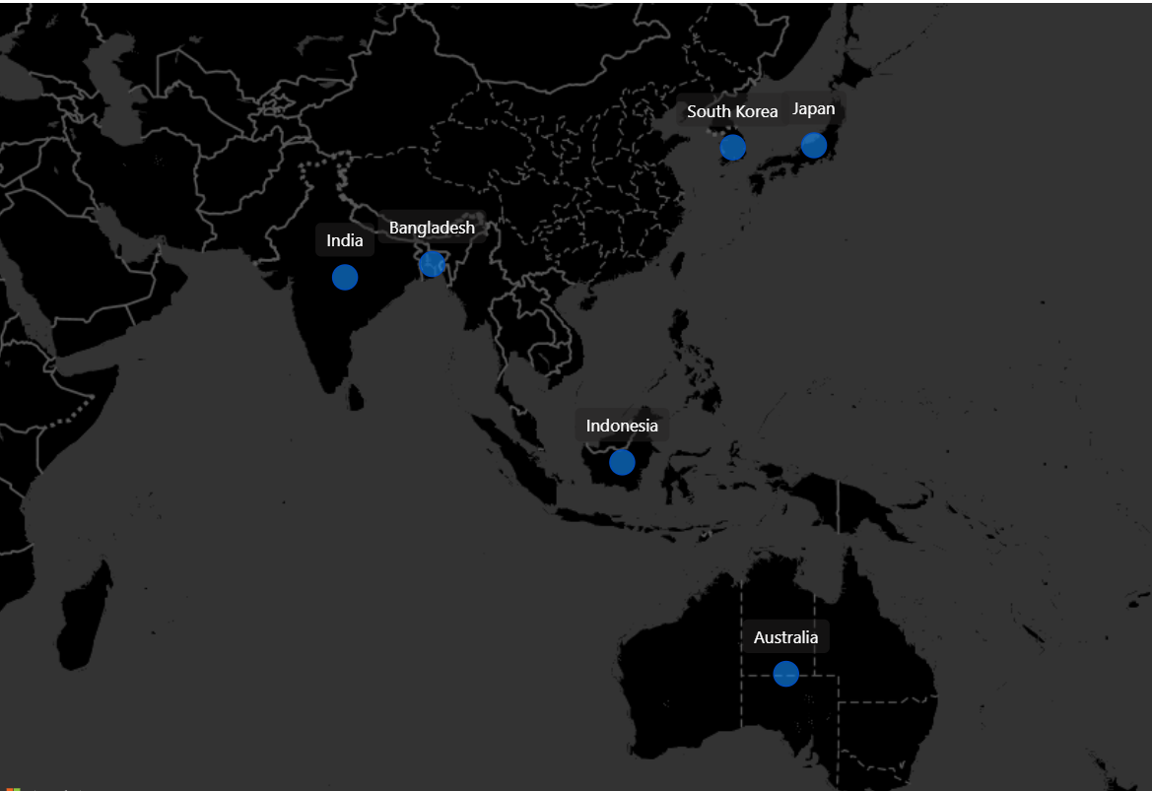
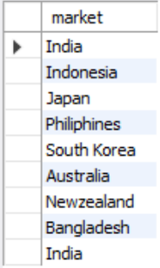
Request 1
1- Provide the list of markets in which customer "Atliq Exclusive" operates its business in the APAC region.

Slide 5
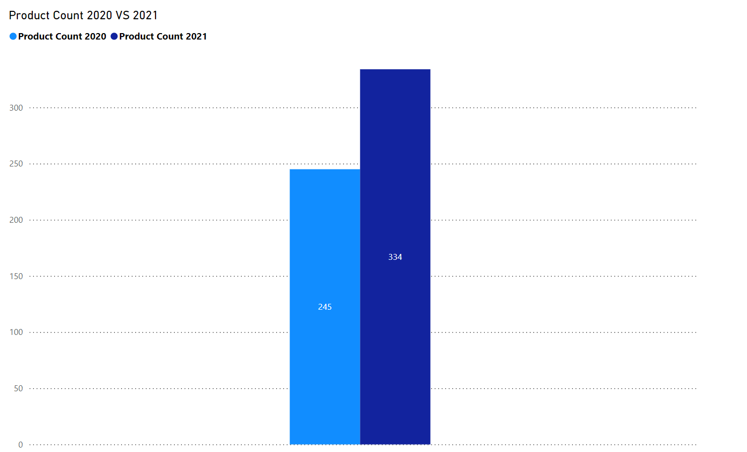

Request 2
What is the percentage of unique product increase in 2021 vs. 2020?
The insight from this data is that there was a 36.33% increase in unique product count from 2020 to 2021. This kind of growth could indicate increased product diversity, potential market expansion, or a strategy to capture a broader customer base by offering more options.

Slide 6
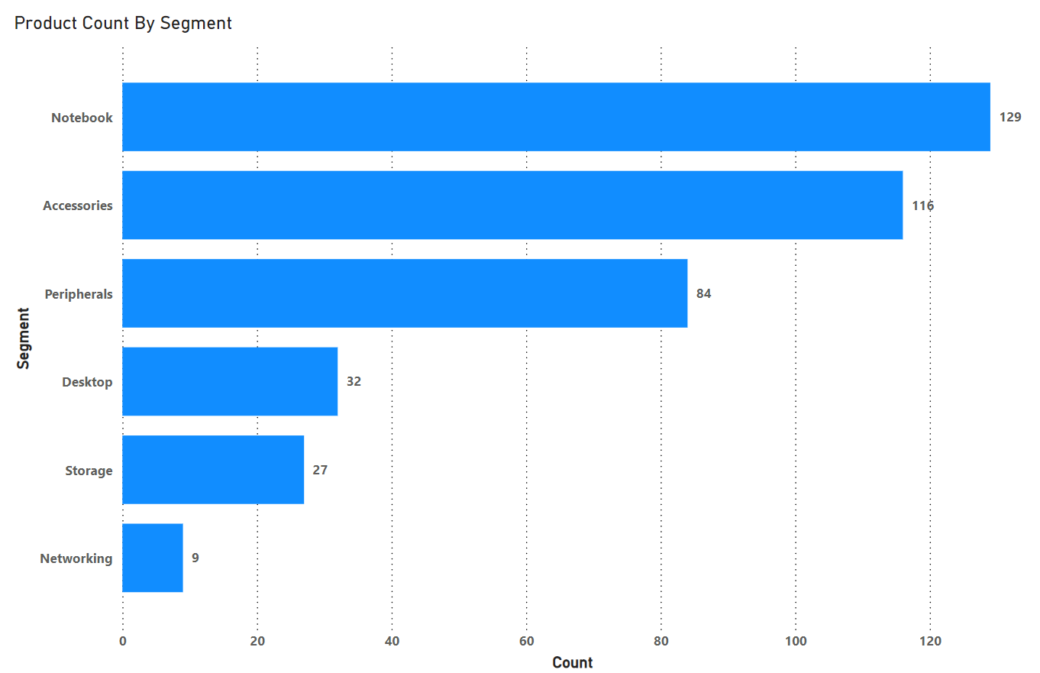
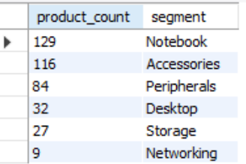
Request 3
3- Provide a report with all the unique product counts for each segment and sort them in descending order of product counts
The report shows that Notebooks, Accessories, and Peripherals have the highest unique product counts, with Notebooks leading at 129. Desktop, Storage, and Networking have significantly fewer products, indicating a possible focus on the top three segments. This suggests a strategy driven by demand or market preference in those areas.

Slide 7
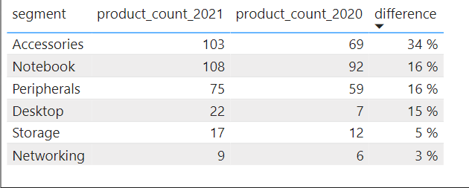
Request 4
Which segment had the most increase in unique products in 2021 vs 2020?
Accessories had the largest increase in unique products, with a 34% rise from 2020 to 2021.
Networking had the smallest increase, growing by 3%, with only 3 more products than in 2020.

Slide 8
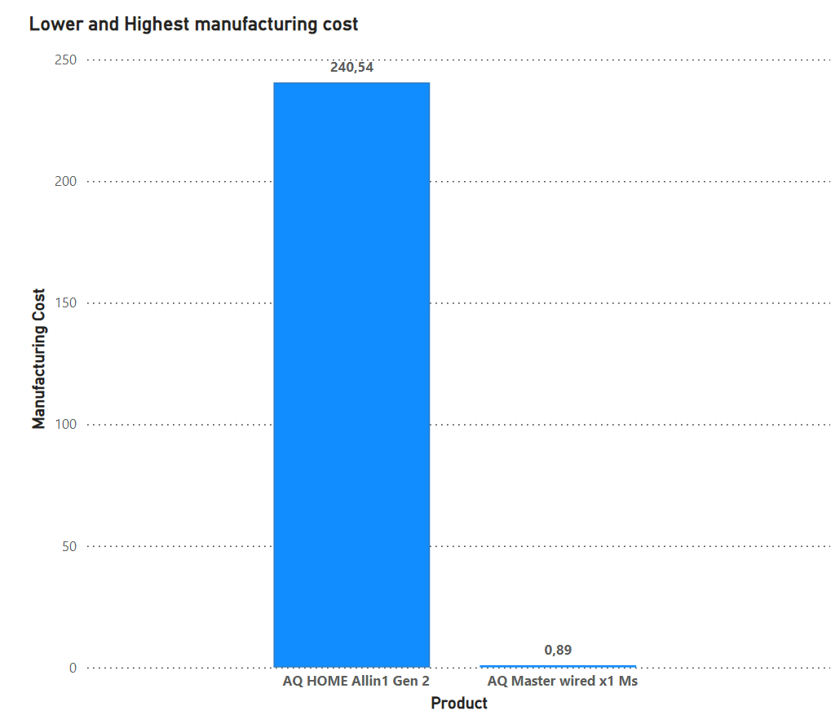
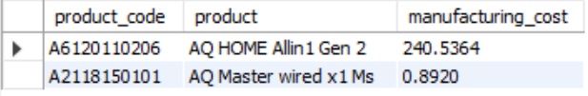
Request 5
Identify the products that have the highest and lowest manufacturing costs.
The product with the highest manufacturing cost is AQ HOME Allin1 Gen 2 at 240.54, while the product with the lowest manufacturing cost is AQ Master wired x1 Ms at 0.89.

Slide 9
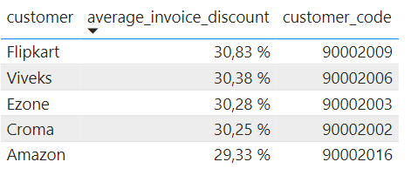
Request 6
Generate a report with the top 5 customers who received a high average discount percentage in 2021 within the Indian market.
Flipkart received the highest average discount, while Amazon, despite being a major player, had the lowest average discount among the top five. This can give insights into discount strategies and customer prioritization in the Indian market for 2021

Slide 10
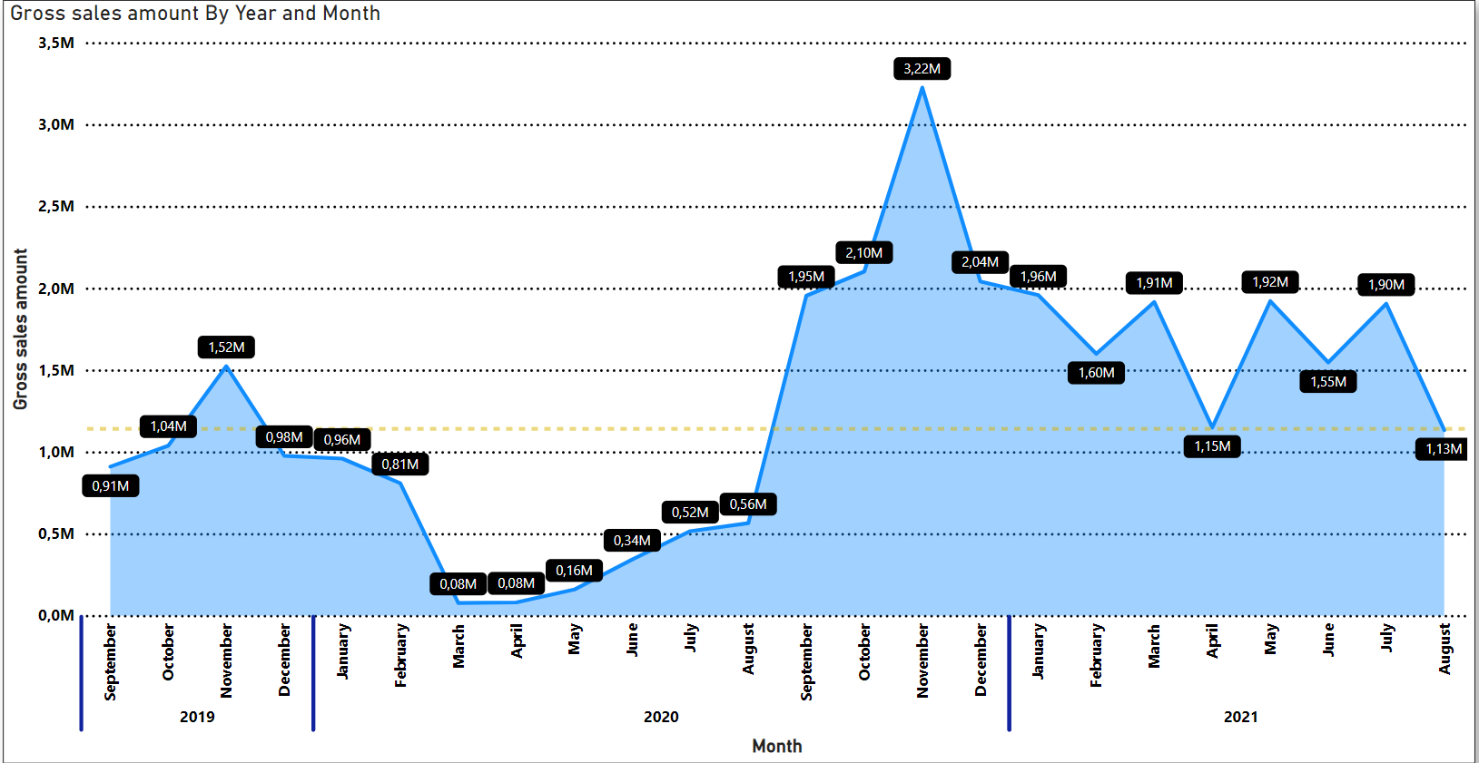
Request 7
7- Get the complete report of the gross sales amount for the customer “Atliq Exclusive” for each month.
1. The lowest gross sales total for both fiscal years occurred in March 2020.
2. The highest gross sales total for both fiscal years occurred in November 2020.
3. 73.8% of the total gross sales figure belongs to FY 2021.

Slide 11
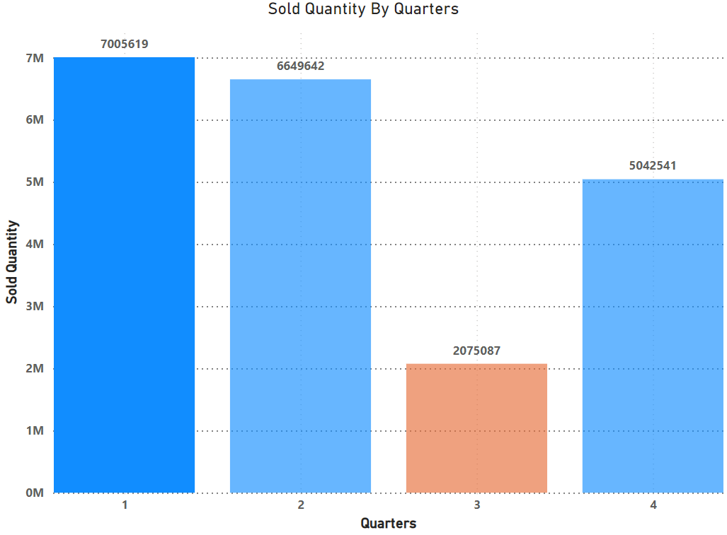
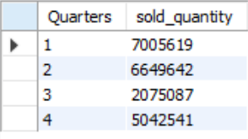
Request 8
Determine the quarter in 2020 that had the maximum total sold quantity.
The quarter with the maximum total sold quantity in 2020 is Quarter 1, with 7,005,619 units sold.
The data shows that Quarter 1 had the highest sold quantity, followed by Quarter 2, Quarter 4, and lastly Quarter 3.

Slide 12
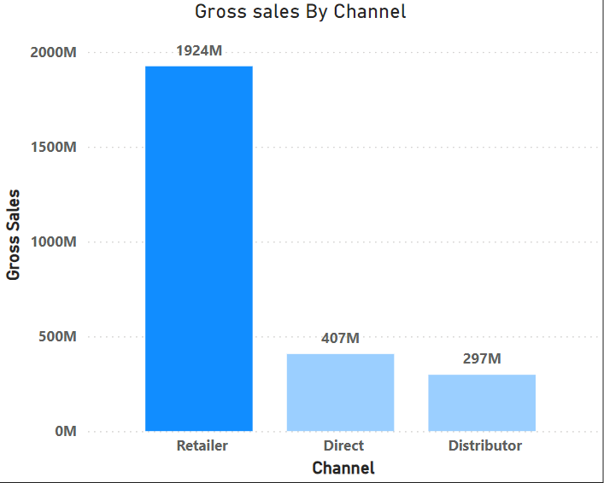
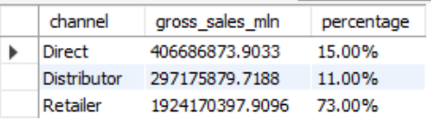
Request 9
Identify the channel that contributed the most to gross sales in 2021, along with its percentage contribution.
Retailer:
Contributed the most to gross sales in 2021 with 73%, amounting to approximately 1924M.
This indicates that the Retailer channel was significantly more impactful in driving gross sales compared to the Direct and Distributor channels

Slide 13
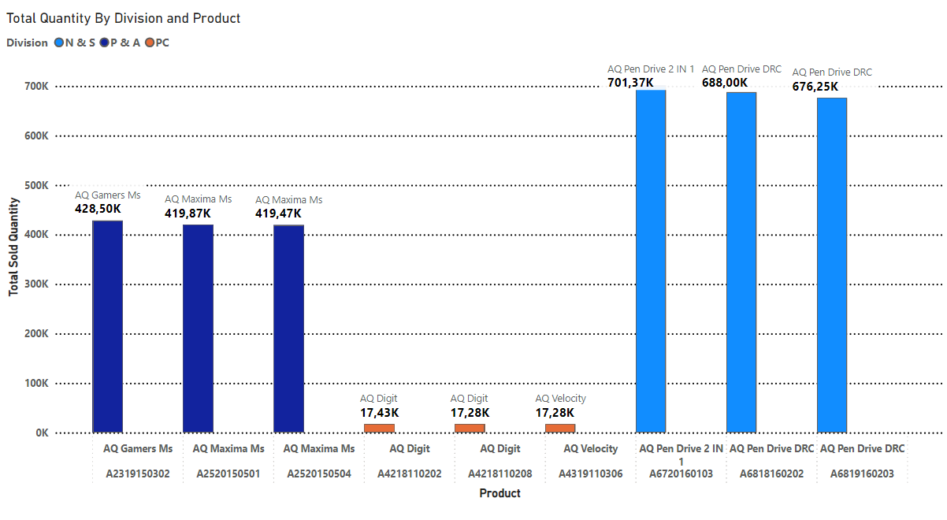
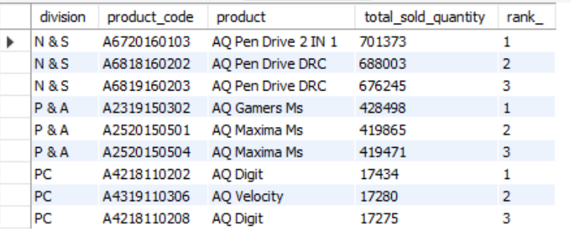
Request 10
Get the top 3 products in each division that had a high total sold quantity in 2021
Insight: Every division features a product with different variants that appears twice in the topthree products by division list.

